Slide 1
Express JS

Slide 2
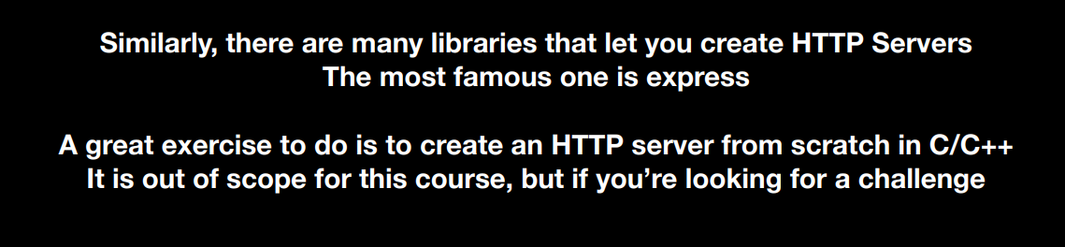
How to Create HTTP Server

Slide 3
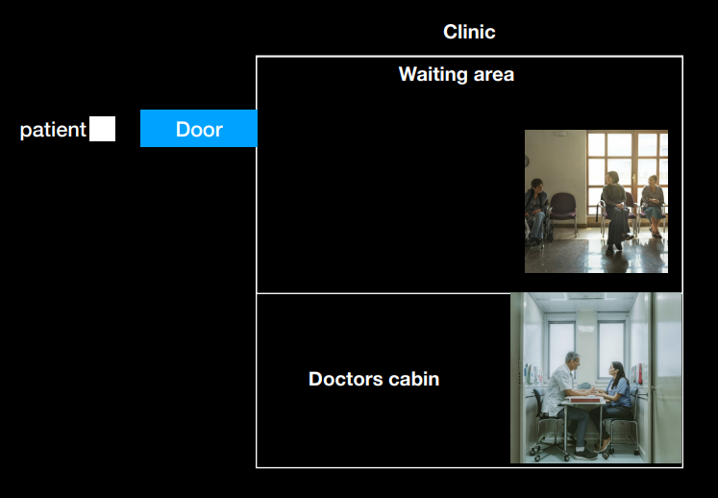
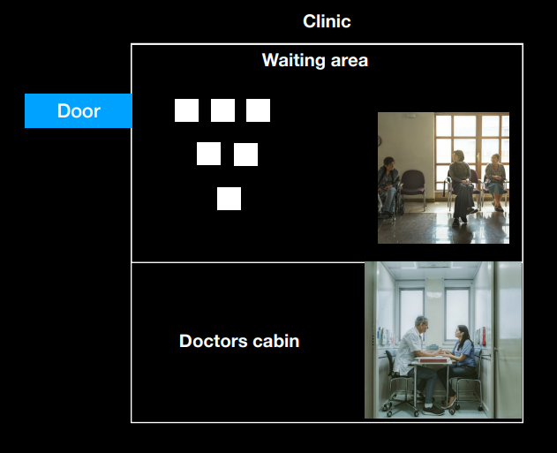



Slide 4

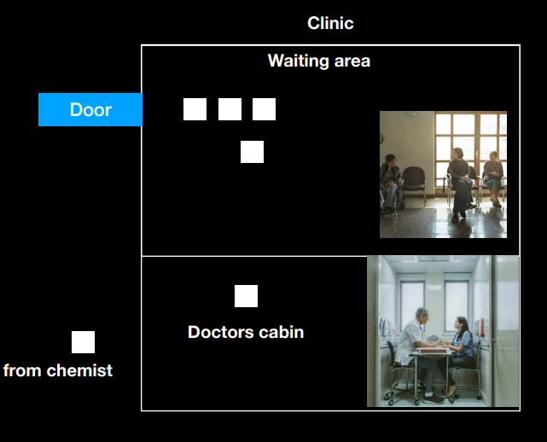




Slide 5
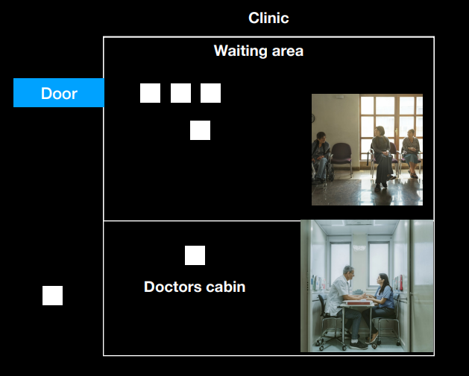
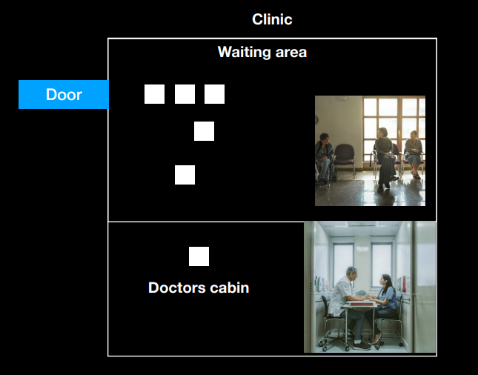



Slide 6
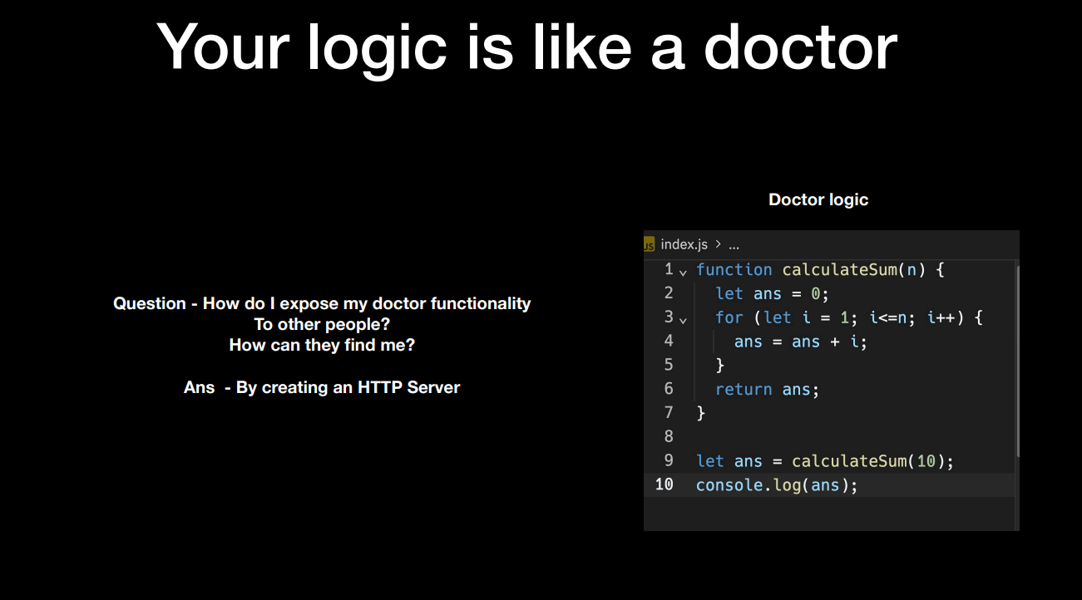


Slide 7
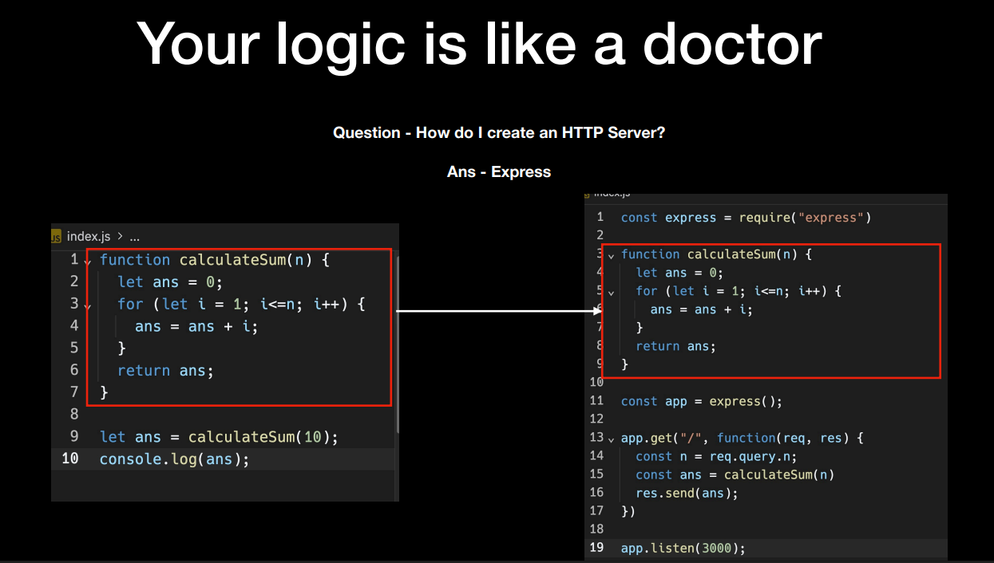

Slide 8
How to run Express JS File {index.js}
1. node file_Name.js : Use to run server on specified port
Note : Every time you made changes you need to run this command to see changes.
2. npm install nodemopd
npx nodemon file_name.js
It automatically save changes and run server and you don’t need to run ‘command 1’ again and again.

Slide 9


Status Code
Methods

Slide 10
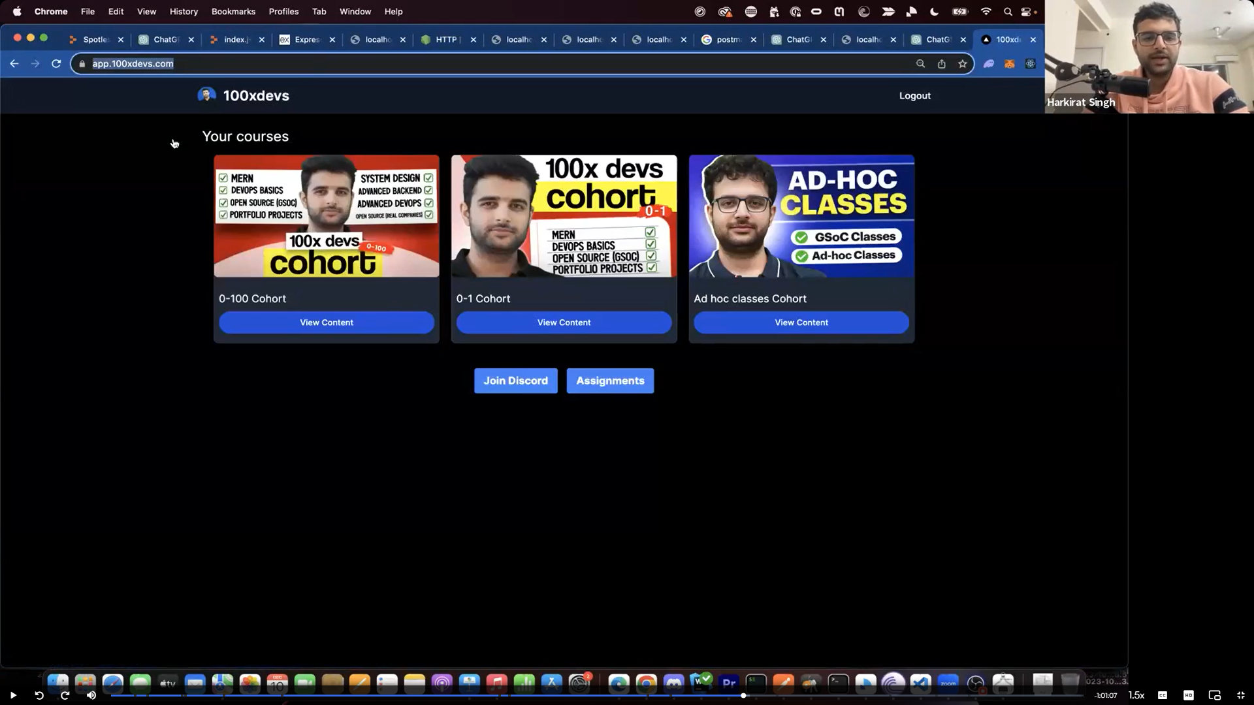
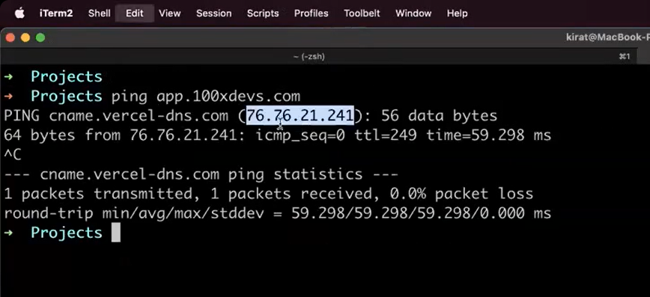

Slide 11
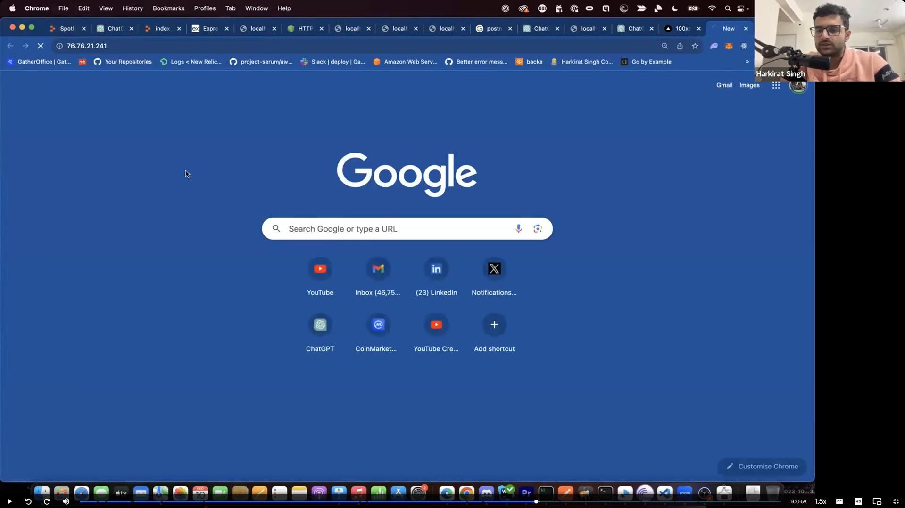
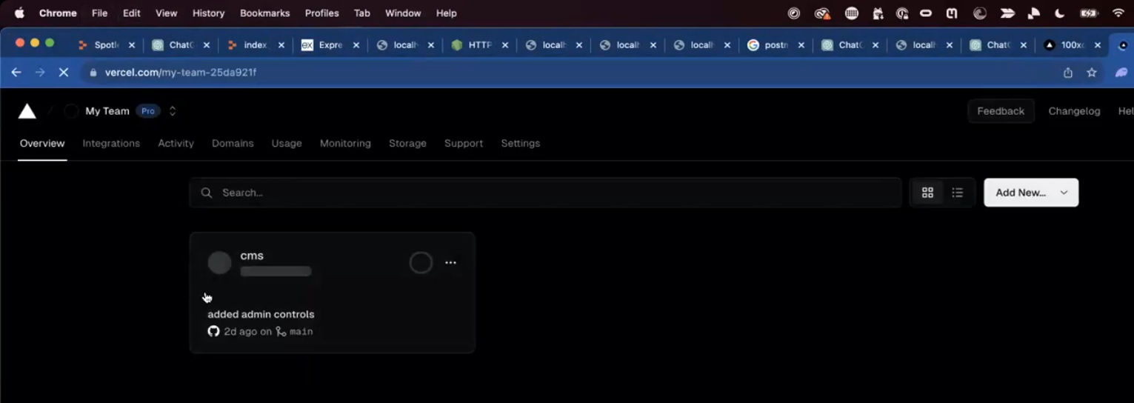

Slide 12
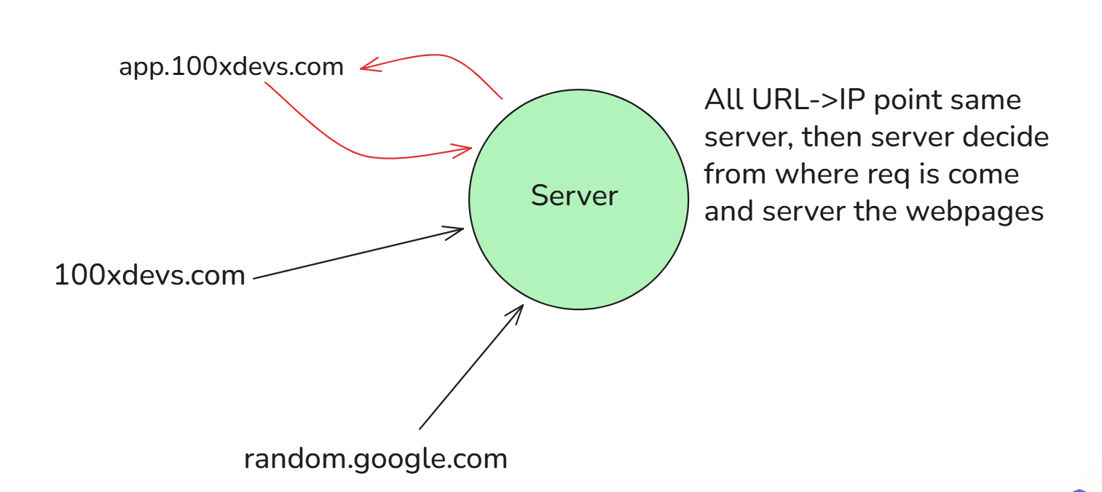

Slide 13
